Slide 1
FLOOD MONITORING SYSTEM
MENTORED by
P. SUJATHA
P. SUJATHA
G.RAJKUMAR
V.POOVIZHI
K.NARAYANAN
B.SURIYA

Slide 2
INTRODUCTION
FLOOD NEAR RIVER
FLOODED ROADS
Integration with MCONEX Flood Monitoring System
RELATED PRODUCT
CONTEXT AND PROBLE
PRODUCT PRESERVATION
FEATURE AND BENEFITS
APPLICATION
ADVANTAGE

Slide 3
INTRODUCTION
Climate change has already had observable effects on the environment. Gradually shifting weather patterns and calamities with catastrophic effects have befallen with increasing frequency due to climate change. The damages and losses to infrastructure, agriculture and properties are huge. Tragically, lives were lost too. One of the ill effects of climate change is the abnormal volume of rains which results to overflowing of rivers and creeks; drainage systems overwhelm with the volume of water flooding roads creating gridlocks and damages to vehicles. Such damages and losses can be mitigated by a flood monitoring system in rivers and roads. Equipped with a monitoring system, disaster response and risk reduction teams of local government units can disseminate information to the public.

Slide 4
FLOOD NEAR RIVER
The most common sources of flooding are rivers and creeks. A flood occurs when a river or a stream overflows its banks caused by rainfall and excess water released by dams or reservoirs. Therefore, it is important to monitor water level in surrounding areas but manual monitoring is fraught with risk, errors and delay. With a flood monitoring system using technology, the water level can be monitored remotely. A non-contact water level sensor is suitable in this application with accuracy. The non-contact sensor can monitor the water level without the need to do extensive maintenance.

Slide 5
FLOODED ROADS
During heavy rainfall, drainage and canal systems are overwhelmed by the onrushing water. And most of the time in urban areas such as Metro Manila, clog drainage system aggravates it. The excess water is left overflowing in roads and highways causing gridlocks and flooding. Flooding can occur with little warning but can also worsen when the rain subsides in low-lying areas serving as a catch basin. People can be caught unaware of the incoming danger of flash flooding with huge losses to properties and sometimes loss of life. A reliable flood monitoring system can minimize the losses and actions can be taken to prevent the taking of life.

Slide 6
Integration with MCONEX Flood Monitoring System
Remote Flood Monitoring Stations are strategically located in flood prone areas and integrated with MCONEX FLOOD MONITORING SYSTEM. MCONEX FLOOD MONITORING SYSTEM will monitor the water levels in all locations remotely and in real-time. A change in water level will trigger the station to send an alert to the central server which will be reflected in the monitoring dashboard of the system and with updates the users/public via SMS/Text and e-mail. The status can also be viewed remotely on a computer or visual display.

Slide 7
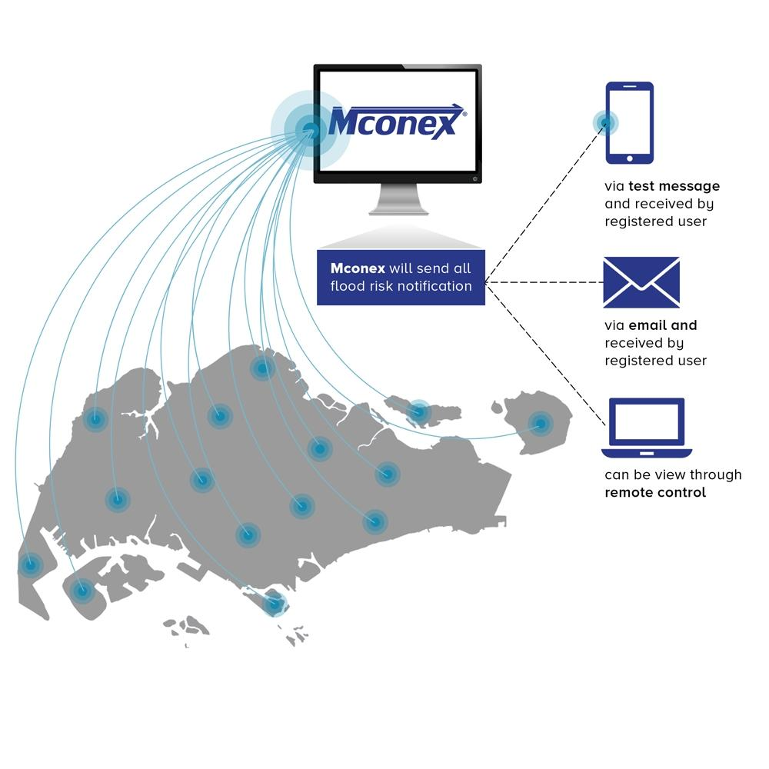
.

Slide 8
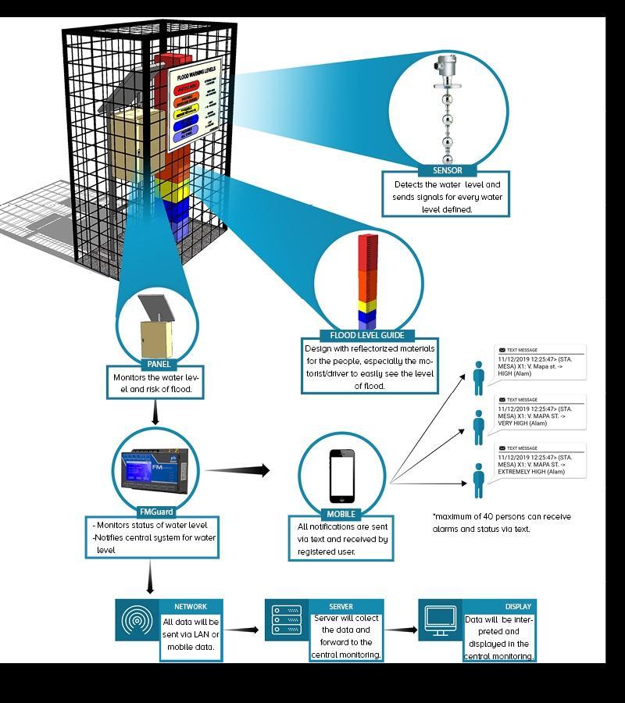
.

Slide 9
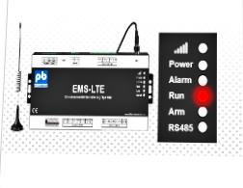
RELATED PRODUCT
EMS-LTE EMS-LTE provides an efficient way of monitoring your equipment while at the same time increasing the productivity of your facility personnel.

Slide 10
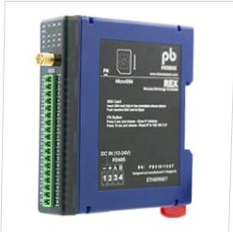
REX A low cost alarm critical monitoring device design to monitor your facilities…

Slide 11
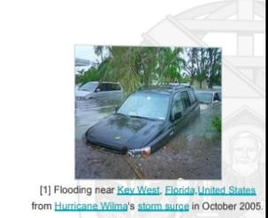
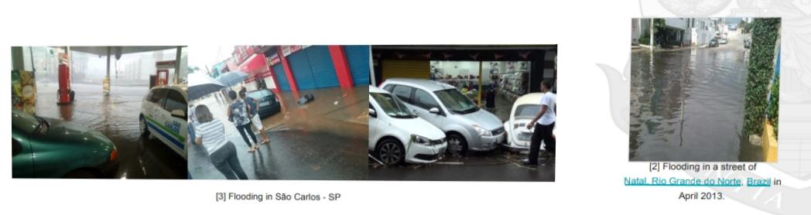
CONTEXT AND PROBLEM
a large amount of water covering an area that is usually dry

Slide 12
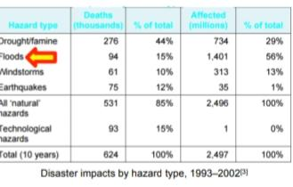
Flash floods are one of the most devastating natural hazards [1.2]Fast-moving and generally violentHigh threat to life and severe damage to property and infrastructure Floods affected many mc

Slide 13
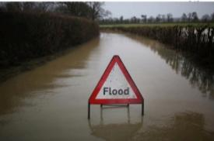
Flood Warning System Provide people and with more time to prepare for flooding Reduce the risk to life and the damage caused → The science of development of flood with river monitoring-based services”

Slide 14
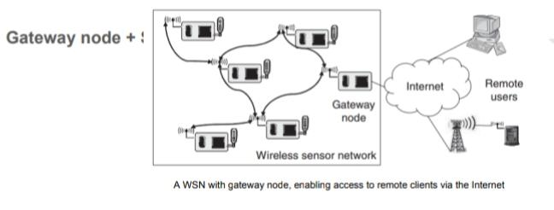
Product Perspective
Flood Monitoring System of System (FMSOS)Support disaster management-related tasks →→River monitoring Communication interface to a wireless sensor network (WSN) for monitoring river levels

Slide 15
FEATURE AND BENEFITS
∆ Able to independently monitor water level on remote site. ∆ Send data of water level status from all sites to a centralized server. ∆ Have a web-based system accessible 24×7 by user via internet connection. ∆ Have a trending feature showing live or historical data. ∆ Have a split screen comparing7 the water movement from four different sites simultaneously. ∆ Overall area map showing live status of each station being monitored.

Slide 16
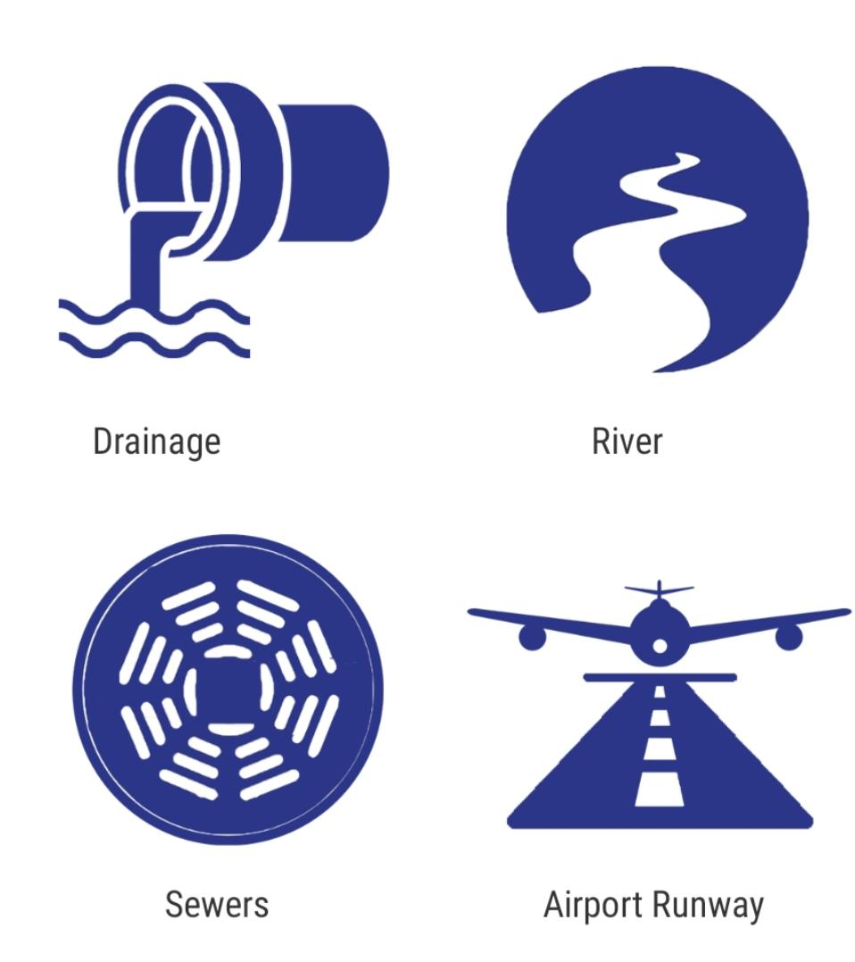
APPLICATION

Slide 17
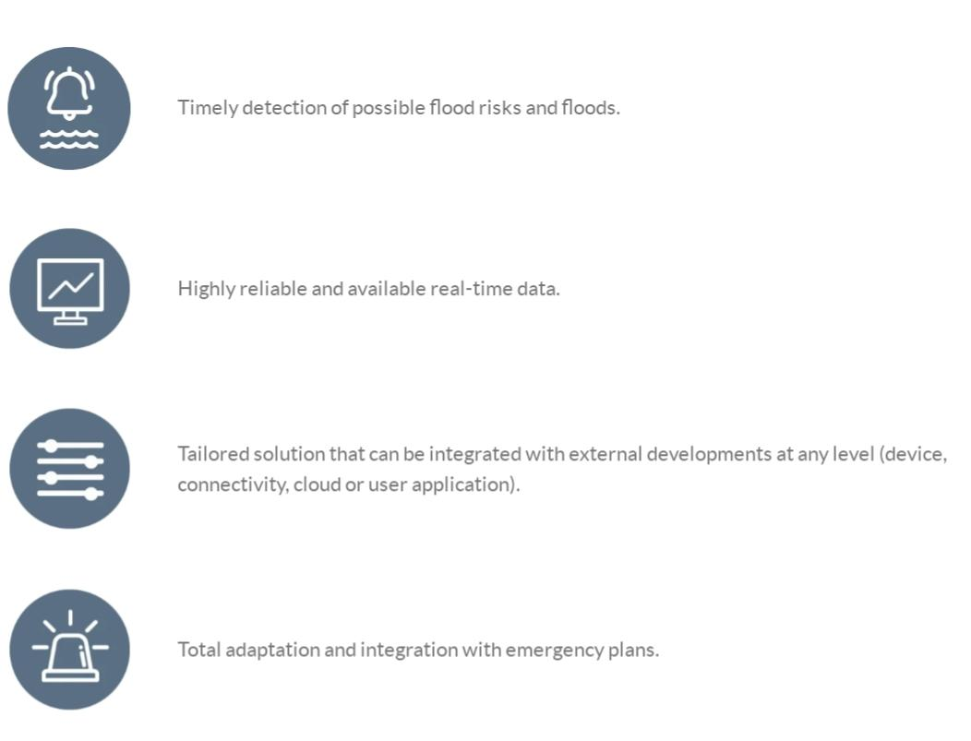
ADVANTAGE

Slide 18
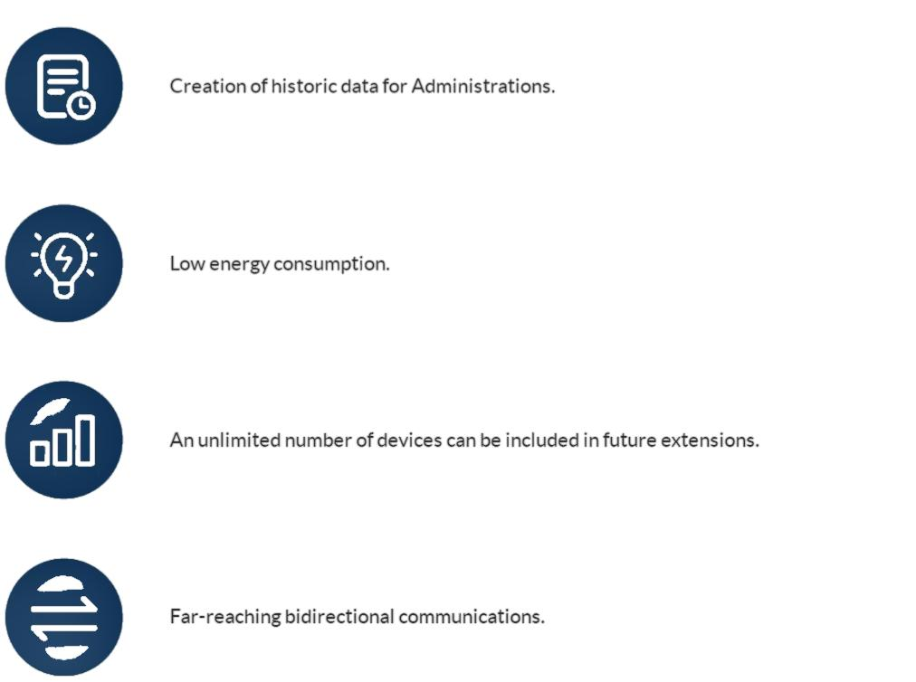

Slide 19
THANK YOU

